Slide 1
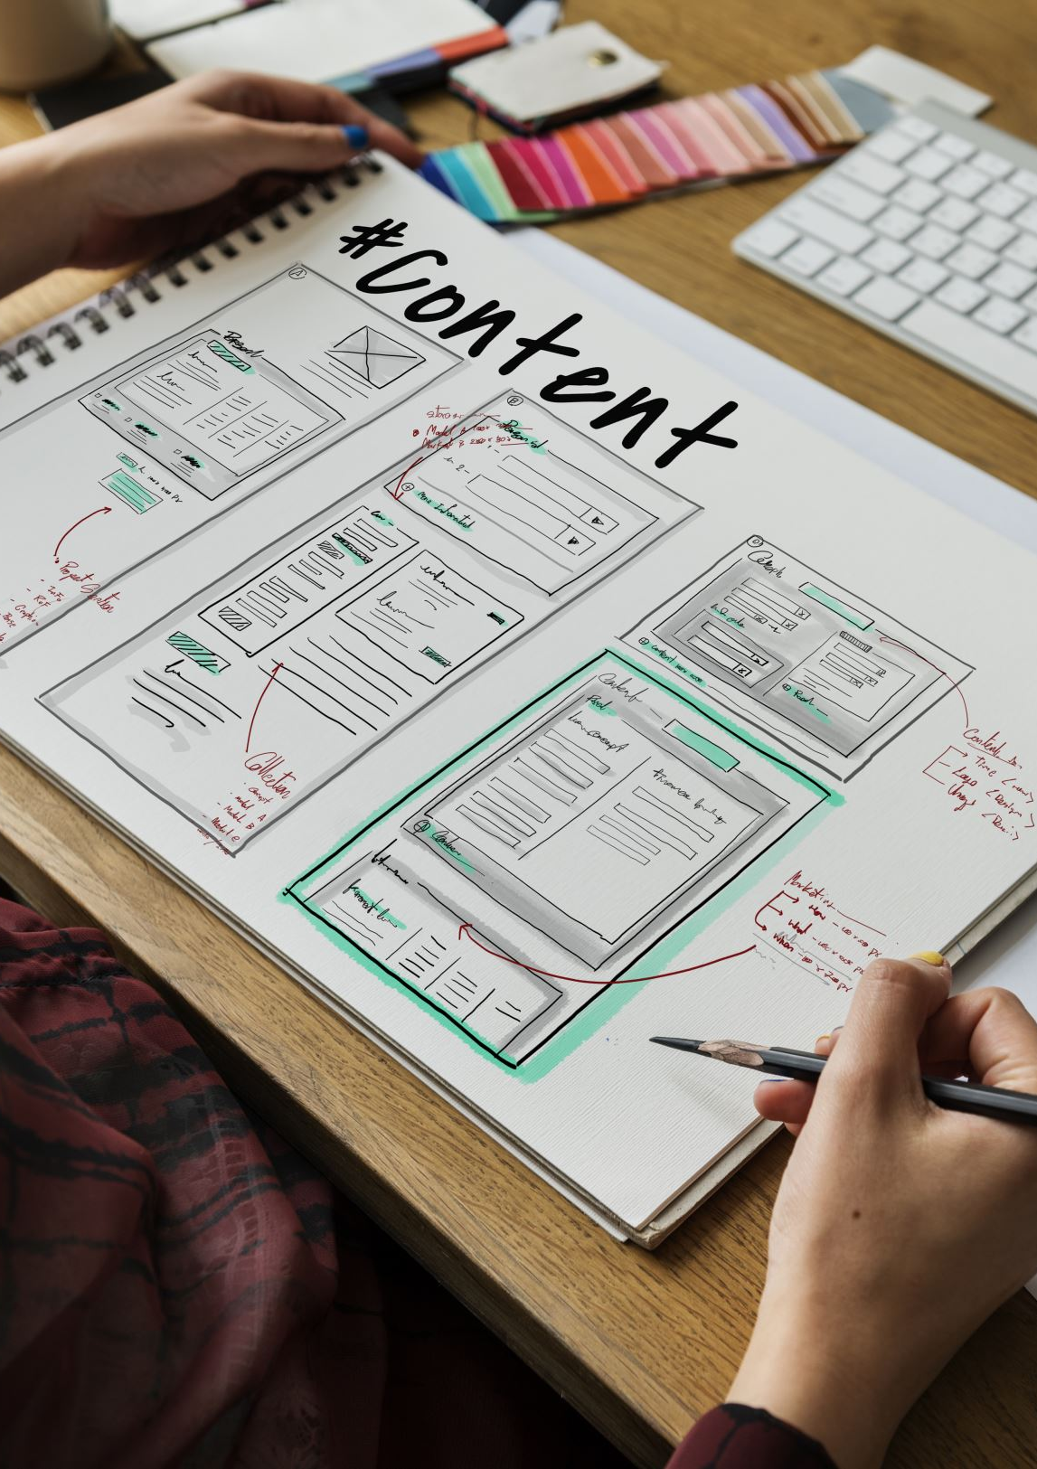
Process Planning Software
Flow Sync
Github Link
Name: Susarla Venkata Parthiv
Registration number: 22011102107

Slide 2

Objectives of Flow Sync (HCI Perspective):
Enhance Workflow Management – Provides tools for better process planning and efficiency in workflow operations.
User-Friendly Interface – Utilizes a well-structured UI with Tailwind CSS to improve usability.
Data Visualization & Tracking – Integrates charts (Chart.js) and advanced interaction methods like eye gaze tracking for better analytics.
Secure & Intuitive Access – Implements a login system to ensure authentication and secure access to process management tools.

Slide 3
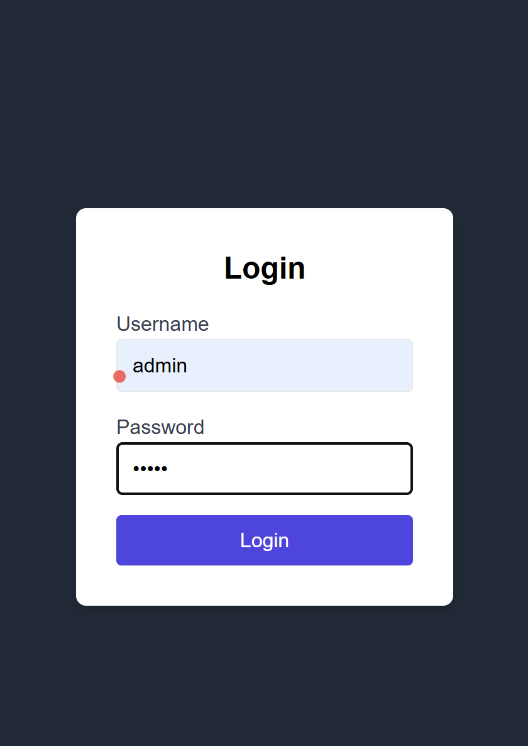
Login Page
Full-Screen Responsive UI
A centrally aligned login interface with a dark-themed background and a white card-style form for contrast and readability.
Secure Authentication System
Likely includes username/password fields with potential for multi-factor authentication (MFA) and backend validation.
Smooth User Experience (UX)
Minimalist design with clear input fields, call-to-action (CTA) buttons, and a responsive layout using Tailwind CSS.
Controlled Access to Main Application
The main app remains hidden (display: none;) until successful authentication, ensuring role-based access and data security.

Slide 4
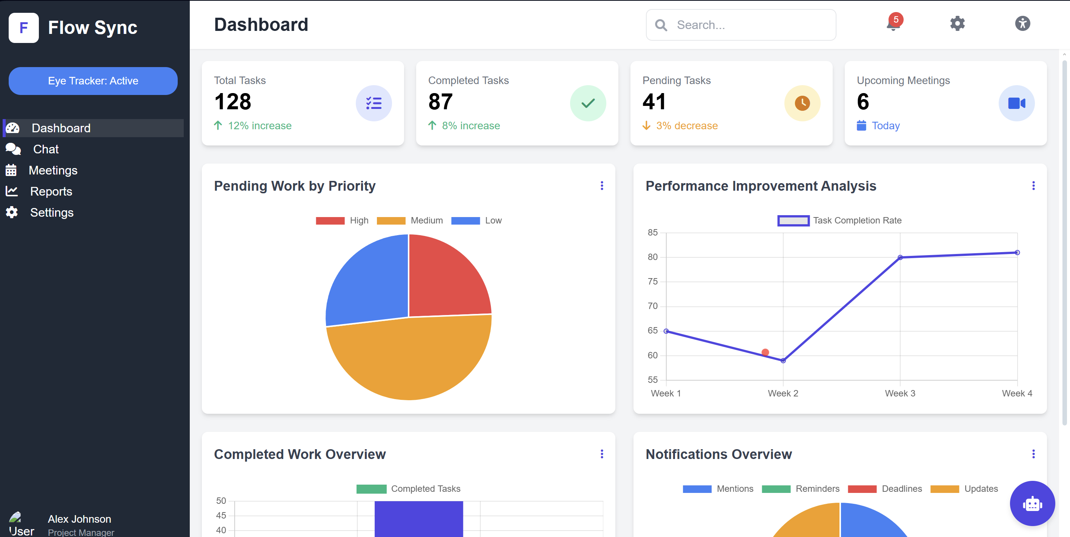
Landing Page – Main dashboard page
Dynamic Data Visualization
Interactive charts and graphs (Chart.js) for real-time insights into workflows, performance metrics, and process efficiency.
Intuitive Sidebar Navigation
A collapsible sidebar menu for quick access to key modules, enhancing user efficiency and navigation.
Customizable Workflow Panels
Modular dashboard cards displaying task status, analytics, and notifications for streamlined process tracking.
Enhanced User Interaction
Supports eye gaze tracking (WebGazer.js) and responsive UI elements for a seamless, adaptive user experience. (red dot on screenshot)
AN AI CHATBOT THAT HELPS IN SIMPLIFYING TASKS AND MAKES LIFE EASIER

Slide 5
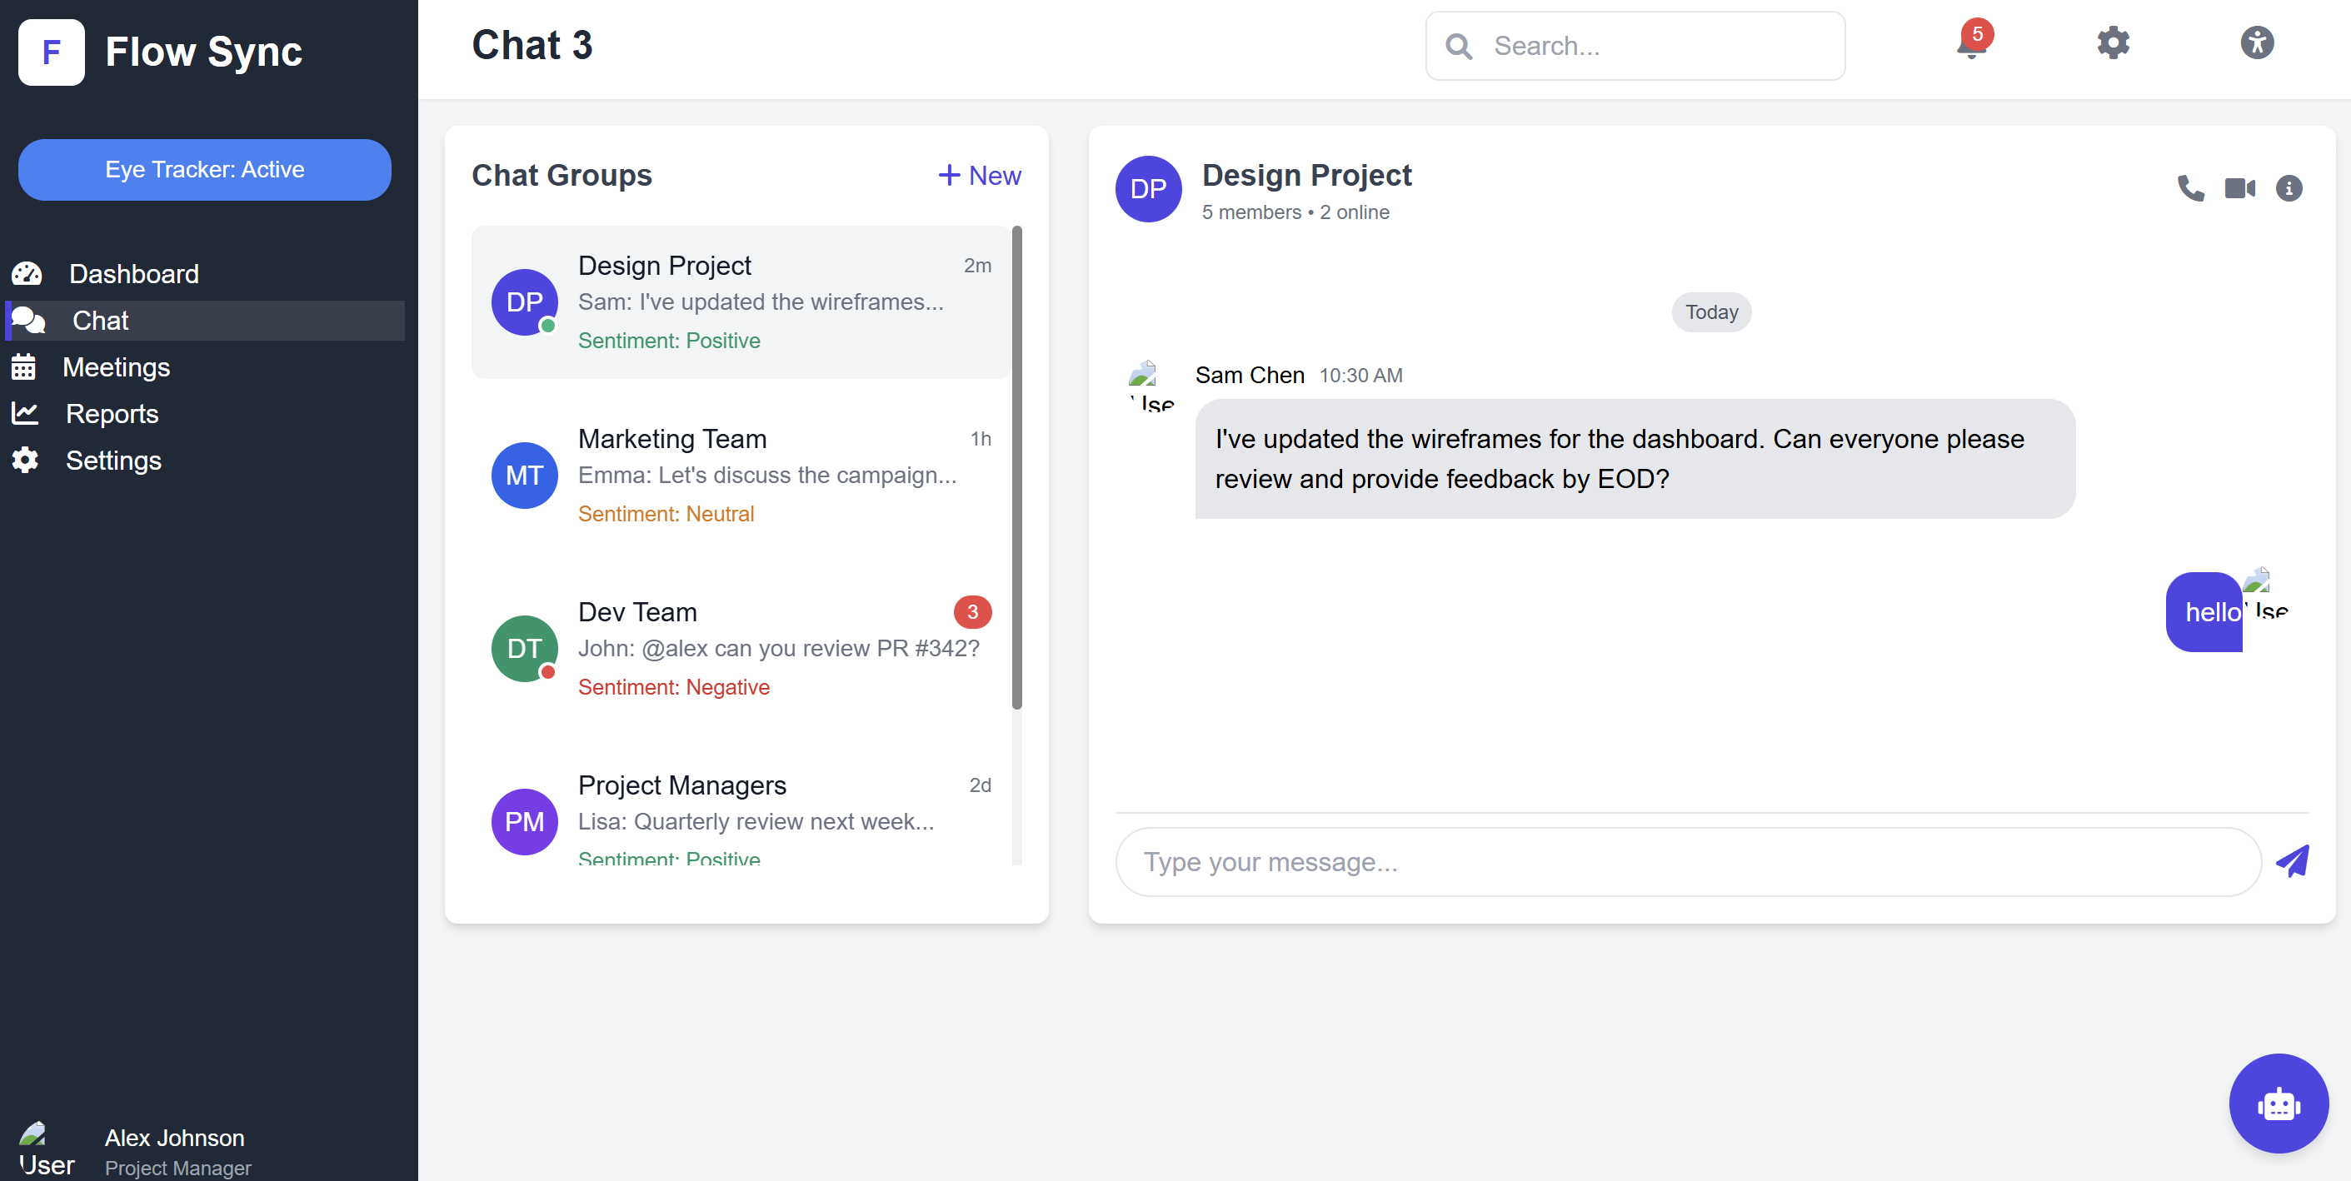
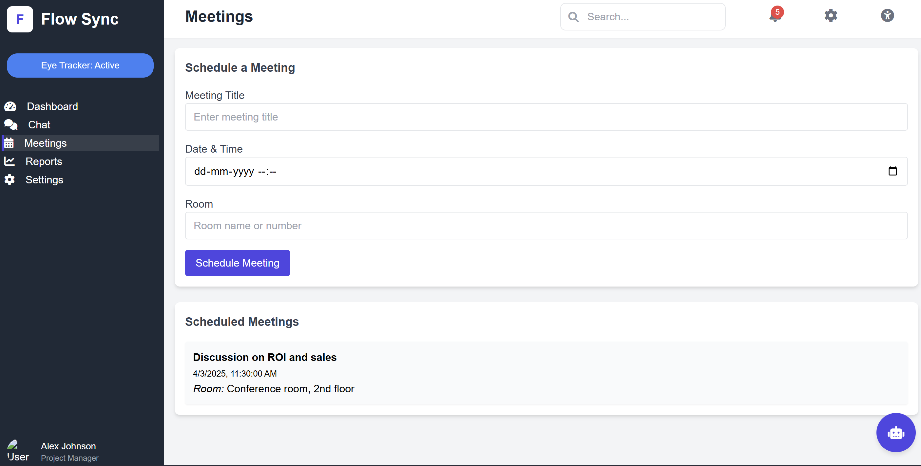
Chat and Meeting page
One can speak with groups and the chat has a sentiment analysis place so that the user knows which chat to prefer.
Meetings can be set and started as necessary

Slide 6
Conclusion
The main points of this project have been highlighted in the ppt here and the rest may be viewed by the viewer by open the website using the github repo link.
AI CHAT BOT, Eye Gazer and accessibility features including notification alerts are included in this project as bonus.

